Slide 1

NED University of Engineering & Technology, Dept of CSIT
CT-472 Data Warehousing & Business Intelligence
Unified E-commerce Analytics:
A Data Warehouse for Integrated Sales and Product Insights
Presented by:
Ebaad Khan DT-22045
Ezaan Khan DT-22046
Syed Ahmed Ali DT-22301
Khuzaima Hassan DT-22302
Presented to: Dr. Umer Farooq

Slide 2

The Goal: A Single Source of Truth
Our primary objective was to design a high-performance data warehouse capable of integrating disparate sales, customer, and product data from various sources.
This project establishes a robust Sales Data Warehouse utilizing a comprehensive ETL pipeline. This clean and unified data foundation facilitates advanced descriptive analytics in Power BI.

Slide 3
The Blueprint: Architecture & Tools
Hybrid Architecture: Bridging On-premise and Cloud
Comprehensive Tech Stack
Data Storage: PostgreSQL (Aiven) for reliable and scalable data warehousing.
Our system employs a hybrid architecture, combining on-premise OLTP systems with cloud-based analytics, structured into four distinct layers:
ETL Pipeline: Python, leveraging libraries like Pandas for data manipulation and SQLAlchemy for database interaction.
Source: Diverse data origins including OLTP Databases, CSV files, and various APIs.
BI & Visualization: Power BI for creating dynamic and insightful dashboards.
Staging: A critical intermediate buffer for data cleansing and preliminary transformations.
Data Science: Python, with Scikit-learn for implementing advanced machine learning algorithms.
Data Warehouse: Built on PostgreSQL, utilizing a meticulously designed Star Schema for optimal querying.
DB Management: pgAdmin, providing a robust interface for PostgreSQL database administration.
Presentation: The final layer for data consumption, featuring Power BI for interactive dashboards and Machine Learning for deeper insights.

Slide 4
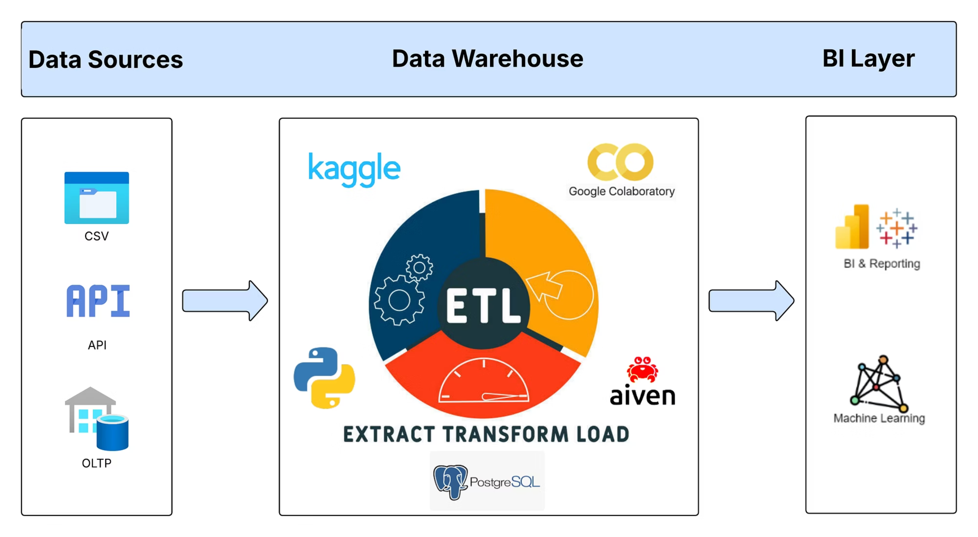

Slide 5

The Model: Star Schema for E-commerce Data
Core Concepts: Facts and Dimensions
Our data warehouse is structured around a classic Star Schema, optimizing for query performance and intuitive data analysis:
dim_customer
Customer details for each sale
Fact Table: fact_sales centralizes key transactional metrics such as price, discount, and quantity for each sale event.
fact_sales
dim_date
Central sales facts with 1-to-many links
Transaction date and calendar attributes
Dimension Tables:
dim_customer: Captures customer attributes (Who).
dim_product_sales
Product info and category hierarchies
dim_date: Provides temporal details for each transaction (When).
dim_product_sales: Details product-specific information (What).
This schema allows for straightforward analysis, enabling quick aggregations and drill-downs into sales data by various dimensions.

Slide 6



The "How": Extract, Transform, Load (ETL)
Our ETL pipeline is the backbone of the data warehouse, ensuring data quality and readiness for analysis.
Extract
Transform
Load
Data is systematically pulled from diverse sources, including OLTP database, Rest API's and CSV file. This process leverages Python using Colab with specialized libraries like Pandas for efficient data handling and SQLAlchemy for seamless database connectivity.
This is the most critical stage, where raw data is refined and prepared. Key operations include:
The transformed, clean data is then loaded into the PostgreSQL Star Schema. This process strictly follows a specific order: dimension tables are populated first, ensuring referential integrity before the fact tables are loaded.
Data Cleansing: Rigorous handling of NULL values and standardization of text formats to ensure consistency.
Business Rules: Application of specific business logic, such as the calculation of profit_margin.
Key Generation: Creation of surrogate keys (e.g., CustomerKey) to maintain data integrity and optimize query performance within the data warehouse.

Slide 7
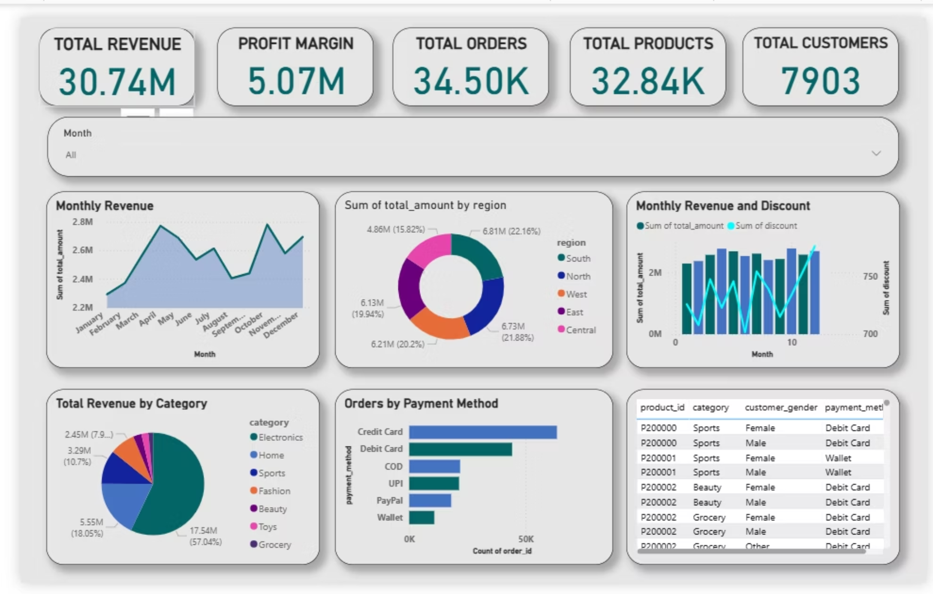
The Result: Power BI Dashboard for Sales Insights
Our interactive Power BI dashboard provides a clear, concise overview of key e-commerce performance indicators.
These KPIs offer immediate insights into the health and performance of the e-commerce operations.

Slide 8
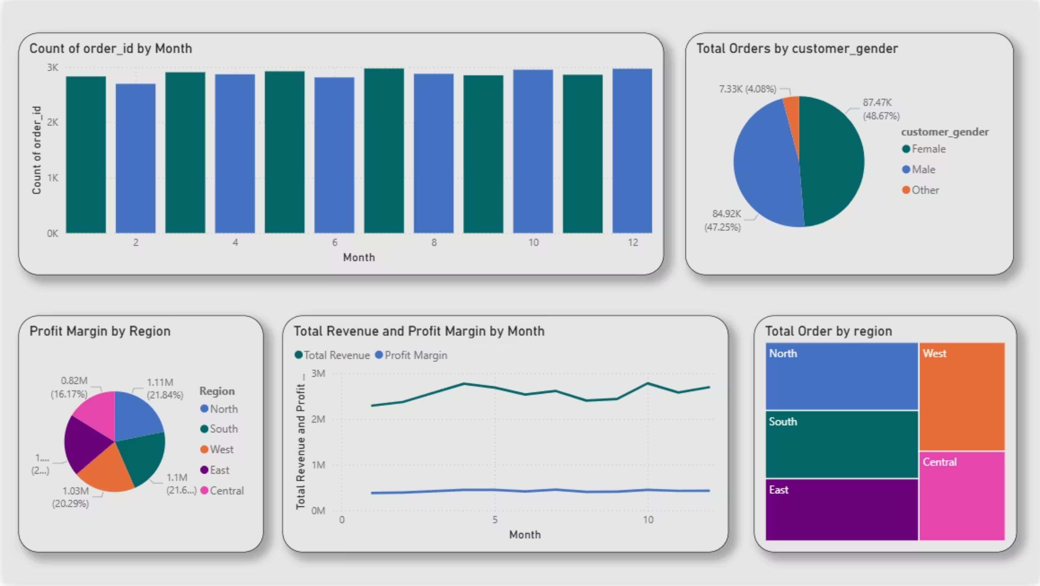

Slide 9

What the Dashboard Told Us: Key Descriptive Insights
Analyzing the Power BI dashboard revealed several critical patterns and trends within our e-commerce data.
Top Category Dominance
Electronics emerges as the leading revenue generator, contributing over 57% to the total sales.
Seasonal Sales Peaks
Revenue consistently peaks during the summer months, specifically from May to August, indicating strong seasonal demand.
Preferred Payment Methods
Credit Card and Cash on Delivery (COD) are the overwhelmingly preferred payment methods among customers.
Younger Demographic Engagement
Customers within the 18-35 age bracket exhibit a significantly higher purchase frequency.
Profit & Discount Correlation
There's a positive correlation observed between our discount strategies and the overall profit margin trend.
These insights are crucial for strategic decision-making in marketing and inventory management.

Slide 10
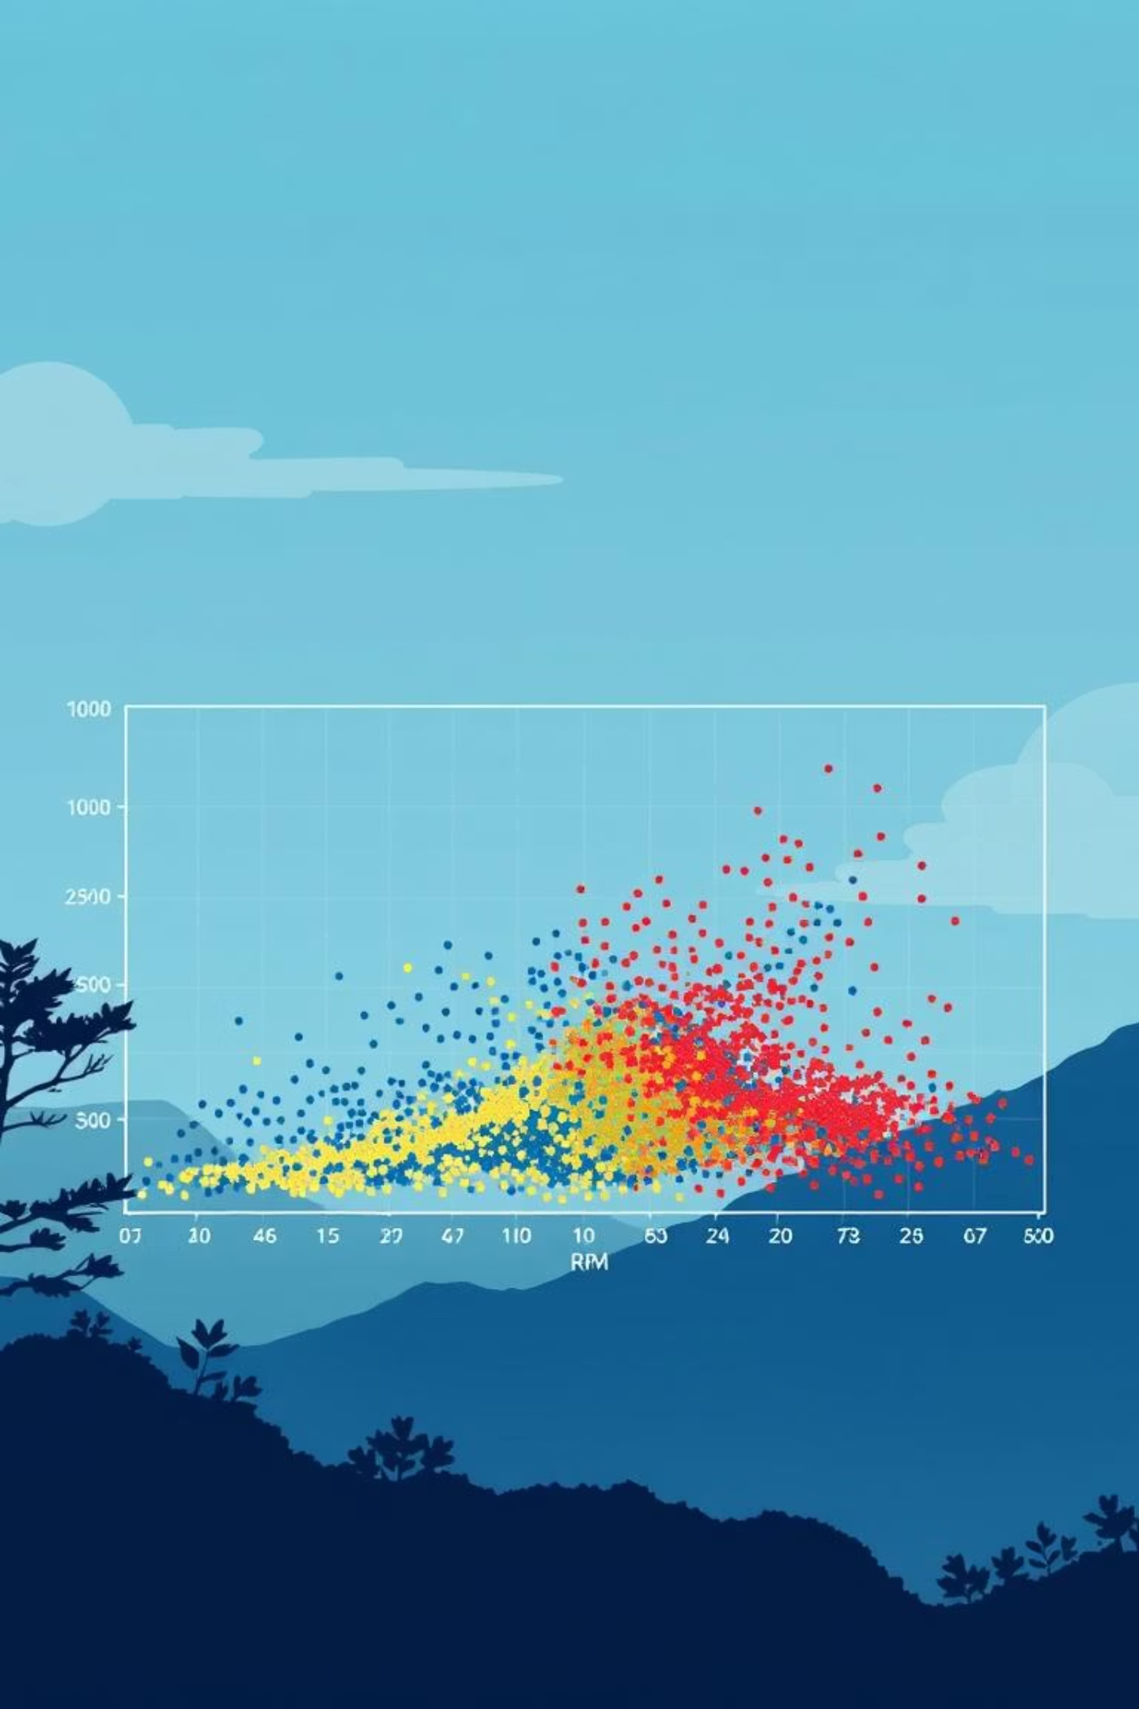
Going Deeper: ML Customer Segmentation (RFM)
To move beyond descriptive analytics, we employed Machine Learning to segment our customer base using the RFM (Recency, Frequency, Monetary) model.
RFM Model
Based on three key metrics:
Recency: Days since last purchase.
Frequency: Total number of purchases.
Monetary: Total amount spent.
Methodology Overview
Data Retrieval: Extracted Recency, Frequency, and Monetary values for each customer directly from the DWH.
Preprocessing: Applied log transformations and scaling to normalize the data and manage skewness, ensuring robust model performance.
Clustering: Utilized the K-Means algorithm (with k=3) to automatically group customers into distinct, actionable segments based on their purchasing behavior.

Slide 11


The Three Customer Segments & Strategic Actions
Our K-Means clustering analysis revealed three distinct customer segments, each requiring tailored engagement strategies.
Segment 0: "At-Risk / Lapsed"
Segment 1: "Loyal Customers"
Segment 2: "Champions / Recent VIPs"
Profile: These customers have an average recency of 205 days, characterized by low frequency and minimal spend.
Profile: While showing high recency (avg. 141 days), these customers have demonstrated significant spend ($1,238). Their recency suggests potential churn.
Profile: Our most valuable segment, with very low recency (avg. 19 days), high frequency, and high spend ($1,042).
Action: Implement targeted "win-back" campaigns, such as special discounts or personalized offers, to re-engage them.
Action: Focus on re-engagement strategies to prevent churn, perhaps through exclusive previews or early access to new products.
Action: Reward their loyalty with VIP treatment, exclusive loyalty programs, and personalized communication to foster continued engagement.

Slide 12

Conclusion & Future Work
This project successfully delivered a comprehensive data warehousing solution, empowering informed decision-making.
Key Accomplishments
Successfully implemented an end-to-end data warehouse, encompassing raw data extraction, meticulous ETL processes, and advanced analytical capabilities.
The system effectively answers "What happened?" through dynamic Power BI dashboards and addresses "Who are our customers?" via sophisticated Machine Learning segmentation.
This integrated approach transforms raw e-commerce data into actionable business intelligence.
This robust foundation enables exciting future possibilities, including the development of predictive models for sales forecasting and customer churn prediction, further enhancing our strategic capabilities.

Slide 13
Thank You

